Slide 1

Medication Preparation Process
Gotthard Panorama Express
Team members:
de Jong Anne Merel
Kenstaviciute Viktorija
Pavloski Djordji
Tennigkeit Donna
Werlen Janosh

Slide 2
Use Case
Problem: Anesthesiologists experience difficulties finding certain medications during preparation for surgery. The search is time consuming and leads to inefficiencies in the preparation workflow.
Our contribution: we modeled the workflow, identified crucial steps in the preparation process and designed automated processes to find medications faster and reduce preparation time.

Slide 3
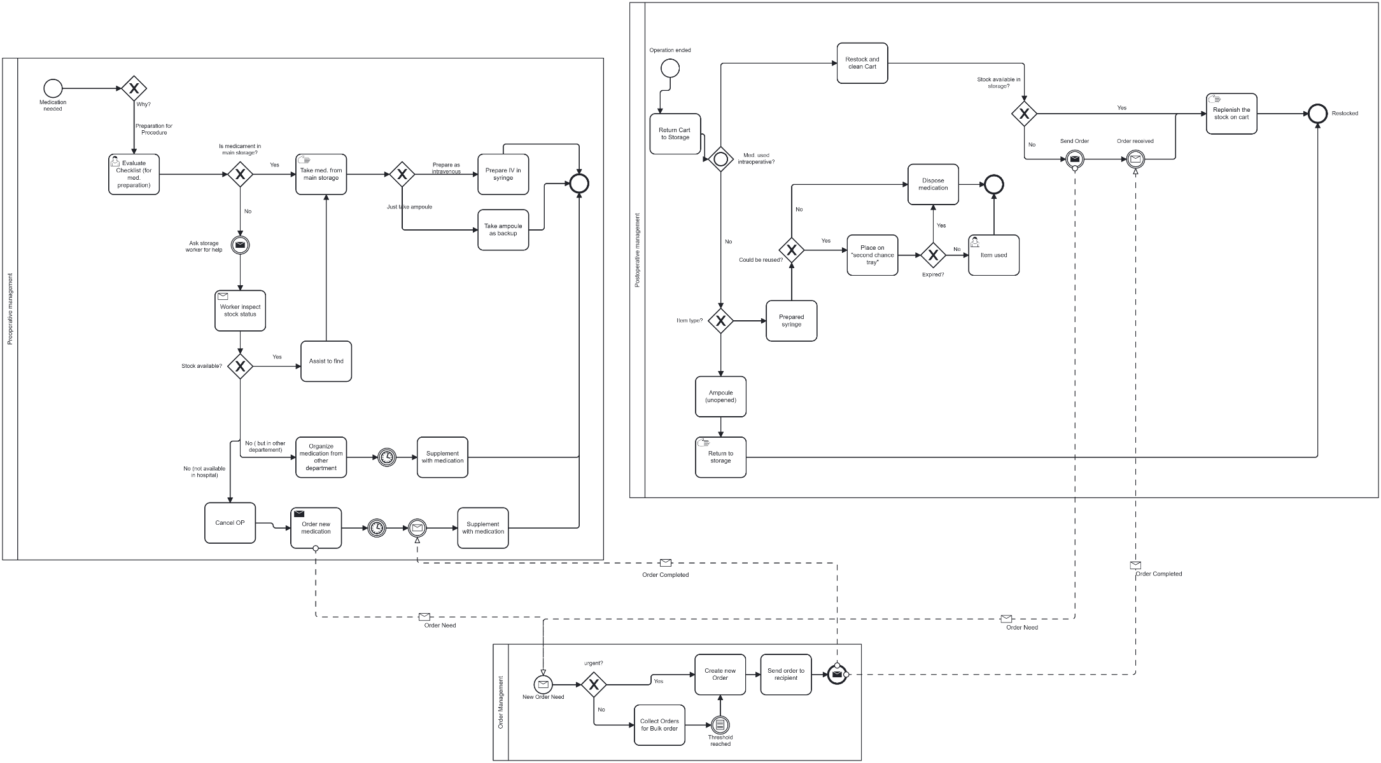
Example of the current process (As-Is Process)

Slide 4
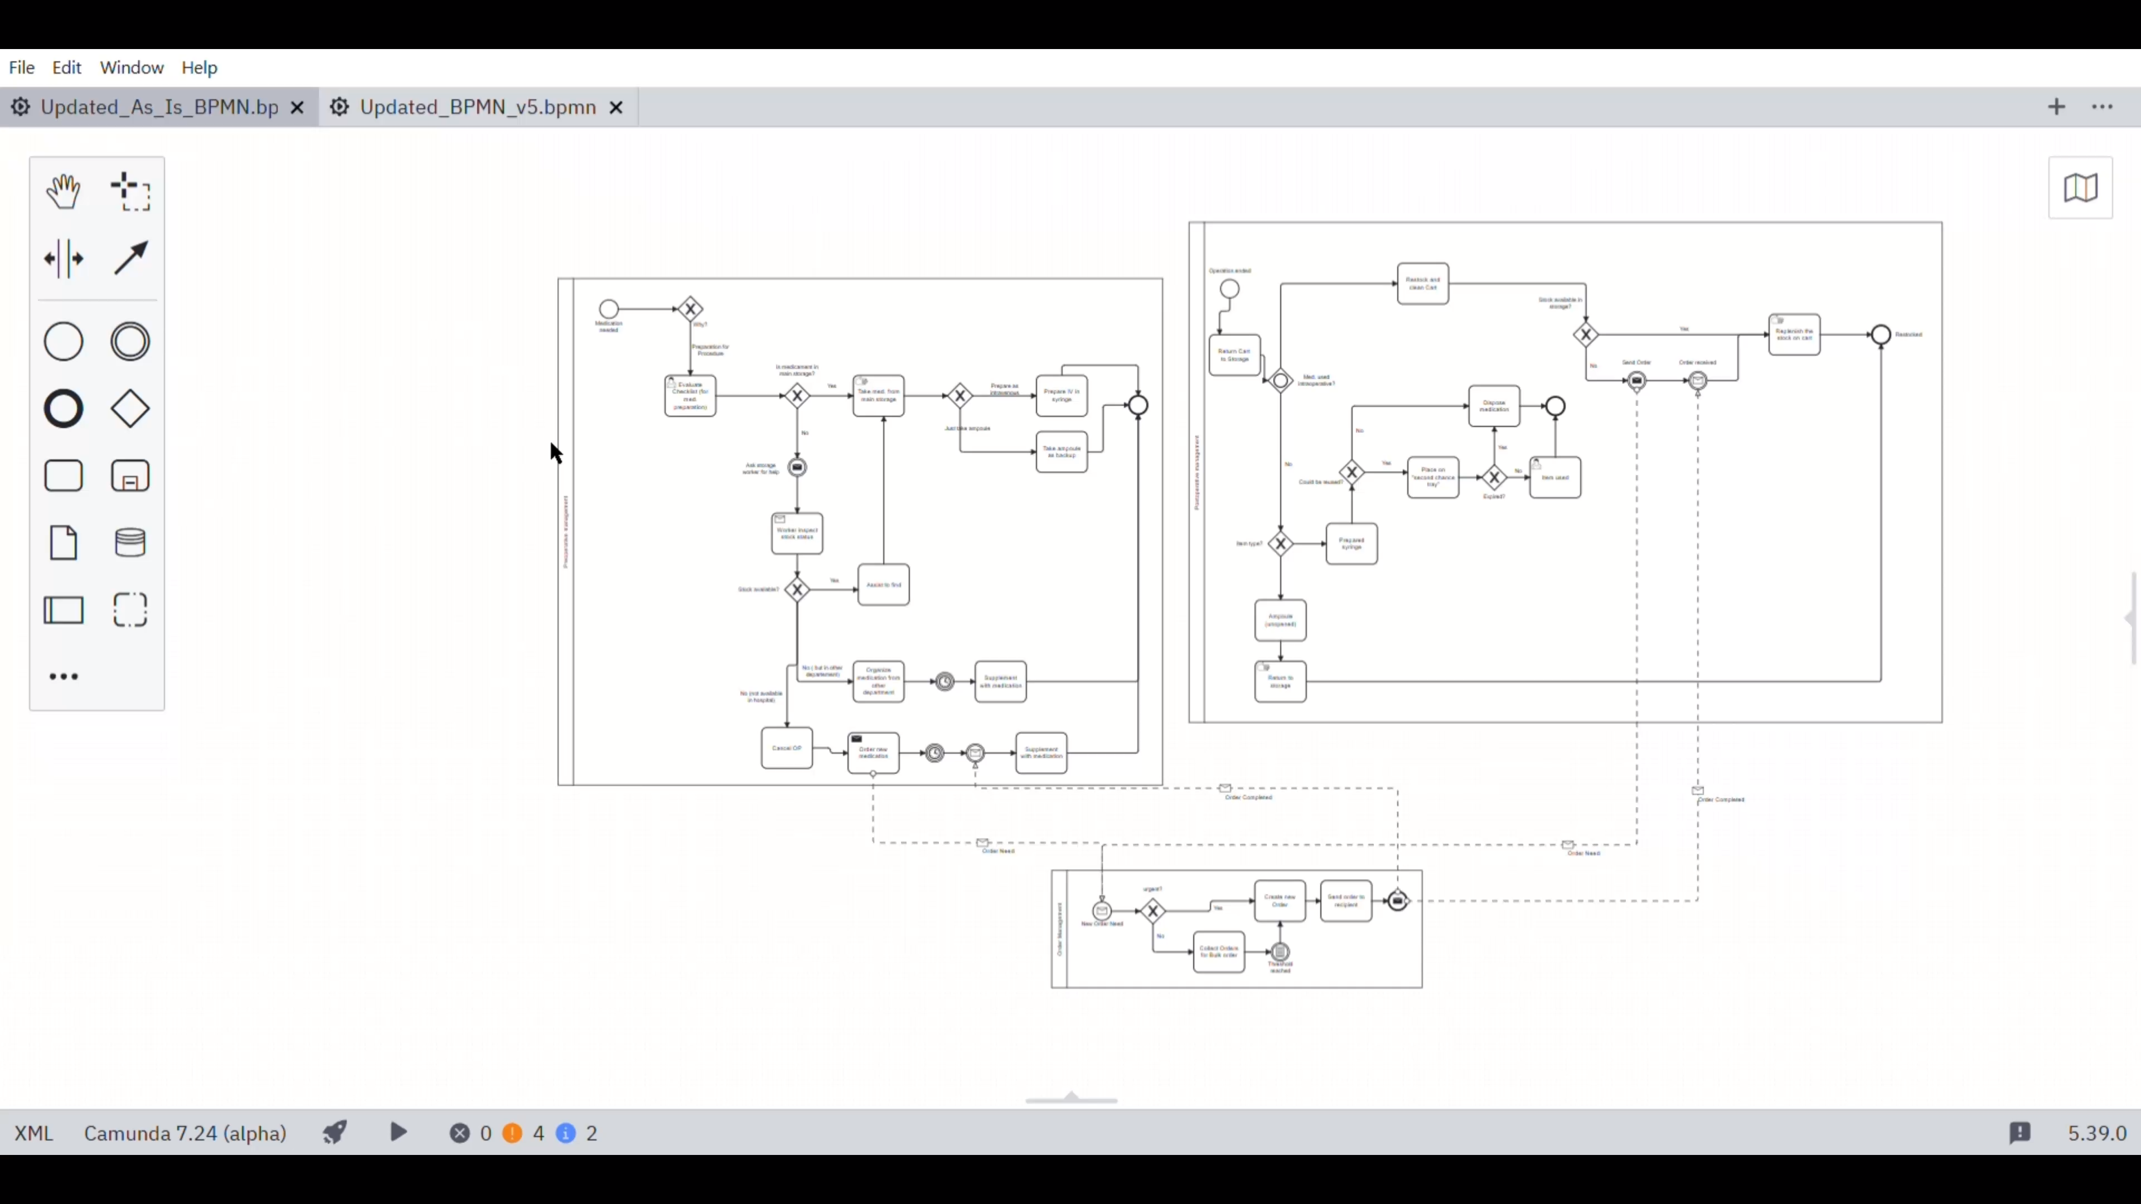

Slide 5
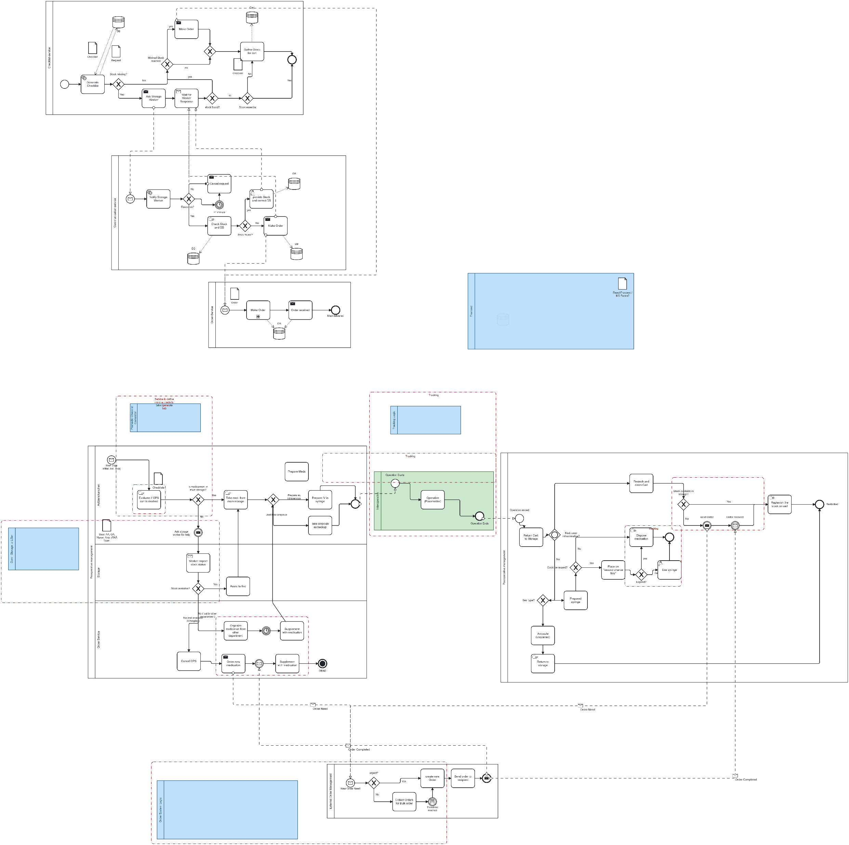
To-Be Process
Medication preparation
Medication tracking & usage
Storage & availability management
Coordination & communication

Slide 6
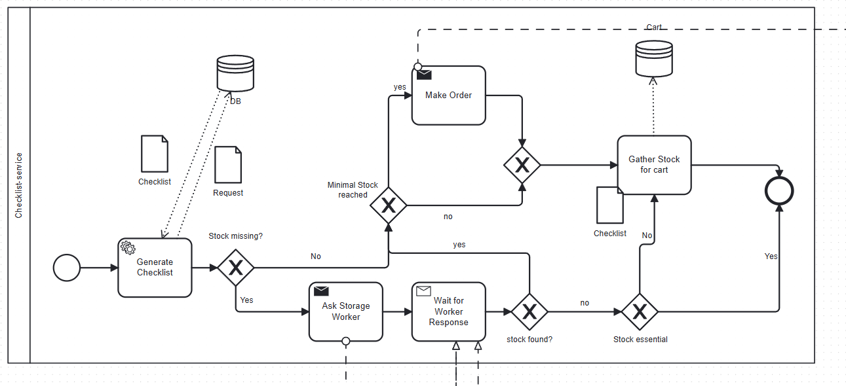
To-Be Process
Medication preparation
Medication tracking & usage
Storage & availability management
Coordination & communication

Slide 7
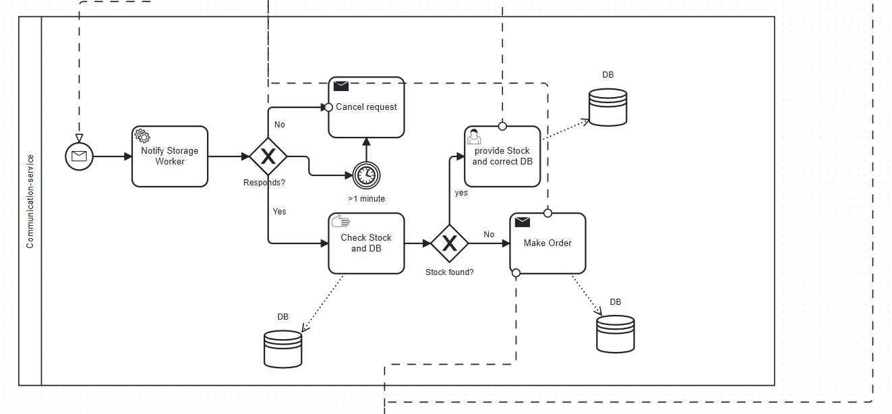
To-Be Process
Medication preparation
Medication tracking & usage
Storage & availability management
Coordination & communication

Slide 8
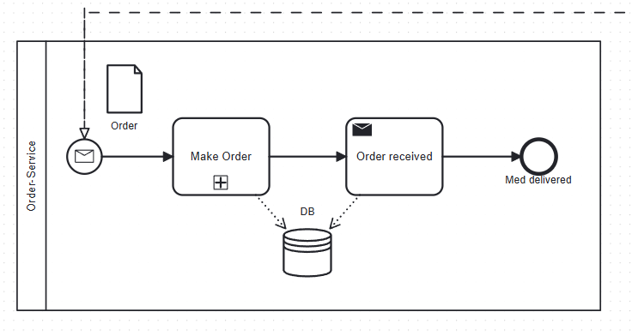
To-Be Process
Medication preparation
Medication tracking & usage
Storage & availability management
Coordination & communication

Slide 9
To-Be Process

Slide 10
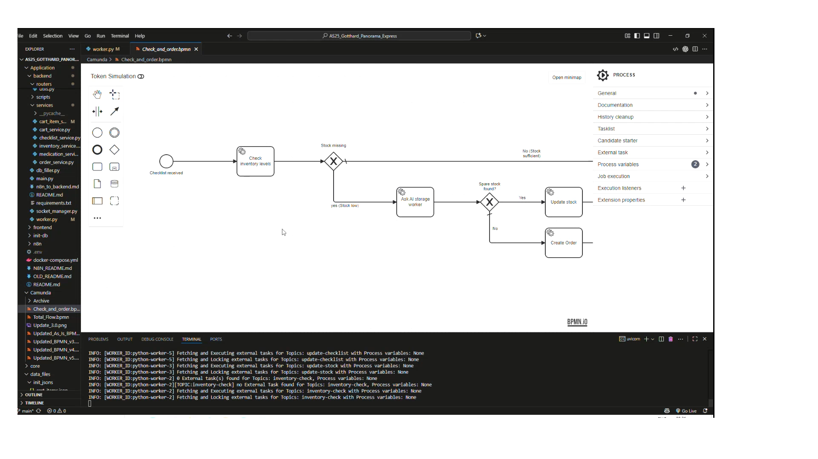
Our proposed solution

Slide 11
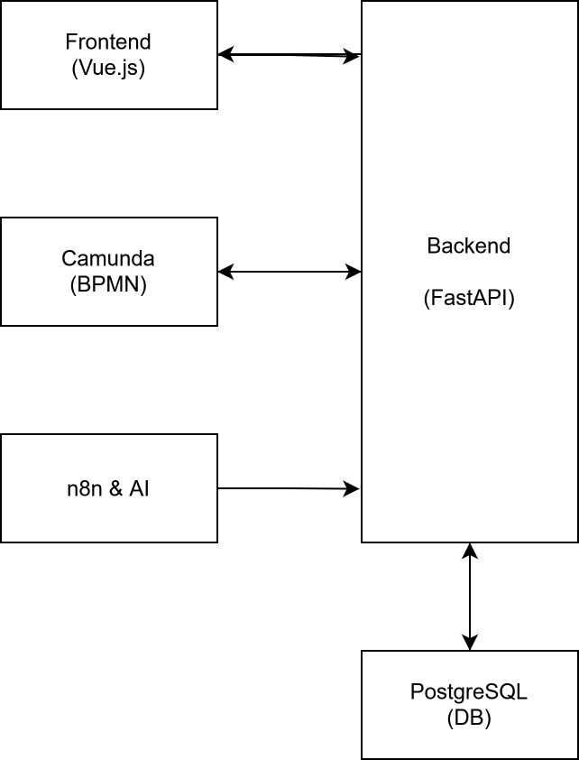
Backend
Execution Engine of the Workflow
Role
Architecture
Logic
n8n & AI Integration
Real-Time Visibility

Slide 12
Conclusion
3 main features:
Digital checklist: tracks prepared and used medications on the carts
Database: stores medication locations, stock levels, and expiry dates, updated in real time
AI based availability check: The system tracks and creates orders automatically when stock is low.

Slide 13

Q&A

